Slide 1
The Phillips Curve
Macroeconomics: Inflation

Slide 2
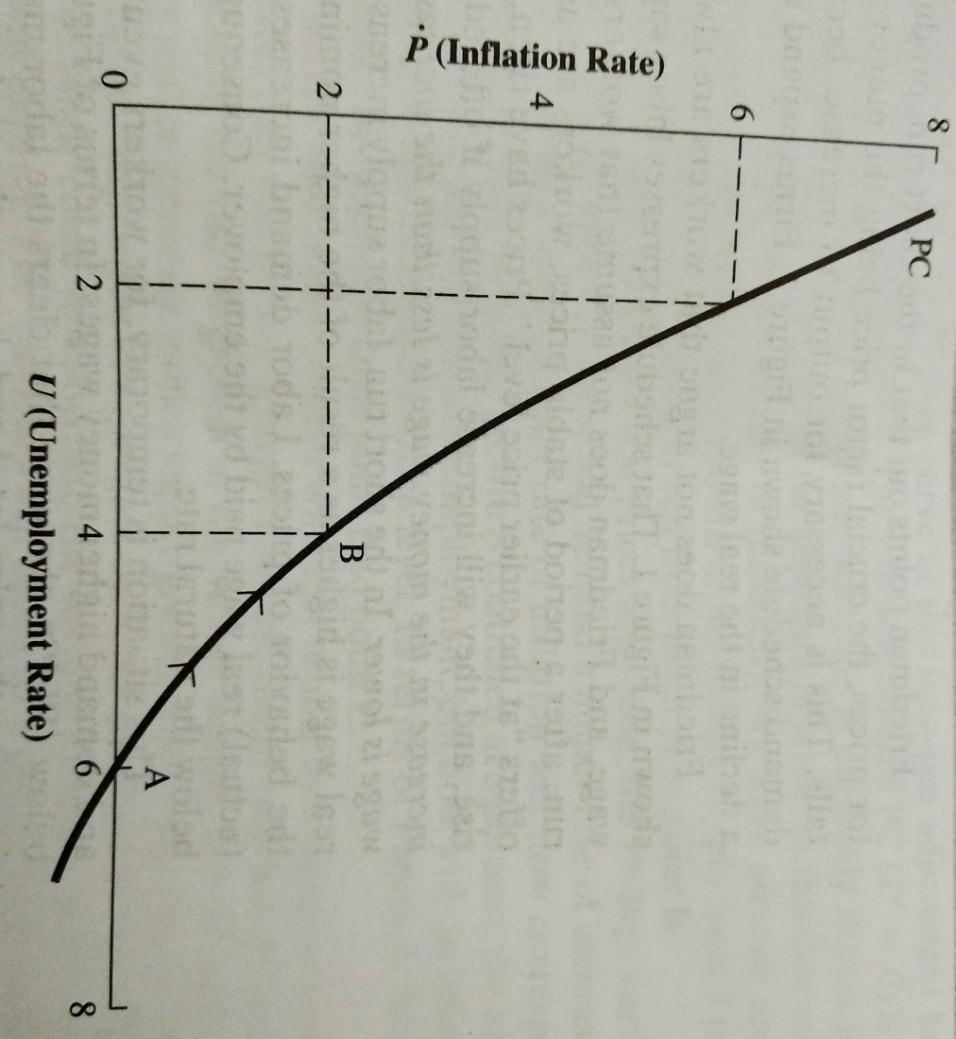
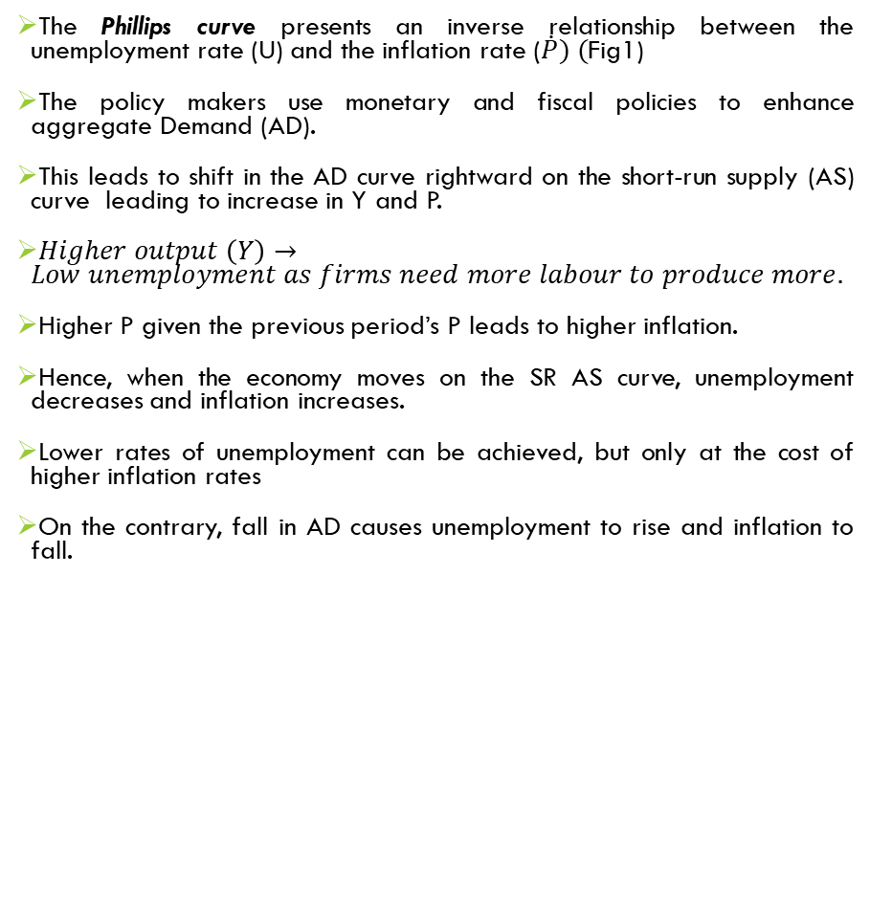
The Phillips curve presents an inverse relationship between the unemployment rate (U) and the inflation rate ($\dot{P}) ($Fig1)
The policy makers use monetary and fiscal policies to enhance aggregate Demand (AD).
This leads to shift in the AD curve rightward on the short-run supply (AS) curve leading to increase in Y and P.
$Higher output \left(Y\right)→Low unemployment as firms need more labour to produce more.$
Higher P given the previous period’s P leads to higher inflation.
Hence, when the economy moves on the SR AS curve, unemployment decreases and inflation increases.
Lower rates of unemployment can be achieved, but only at the cost of higher inflation rates
On the contrary, fall in AD causes unemployment to rise and inflation to fall.
Figure 1: In the short run, an increase in the rate of growth in the money supply moves the economy from pt A to pt B→ unemployment declines and inflation rises

Slide 3
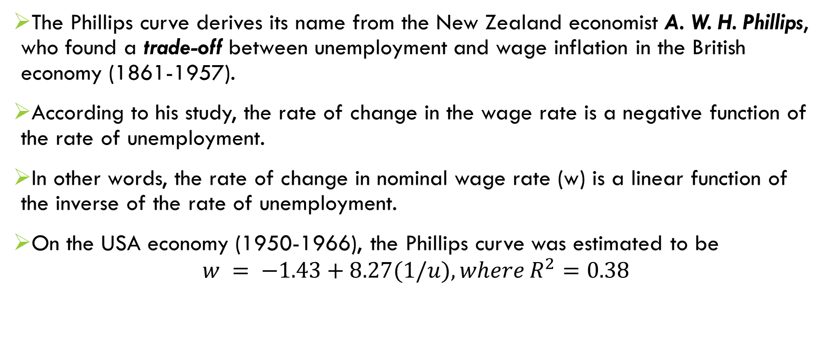
The origin of the Phillips curve
The Phillips curve derives its name from the New Zealand economist A. W. H. Phillips, who found a trade-off between unemployment and wage inflation in the British economy (1861-1957).
According to his study, the rate of change in the wage rate is a negative function of the rate of unemployment.
In other words, the rate of change in nominal wage rate (w) is a linear function of the inverse of the rate of unemployment.
On the USA economy (1950-1966), the Phillips curve was estimated to be
$$w = −1.43+8.27(1/u), where R^{2}=0.38$$

Slide 4
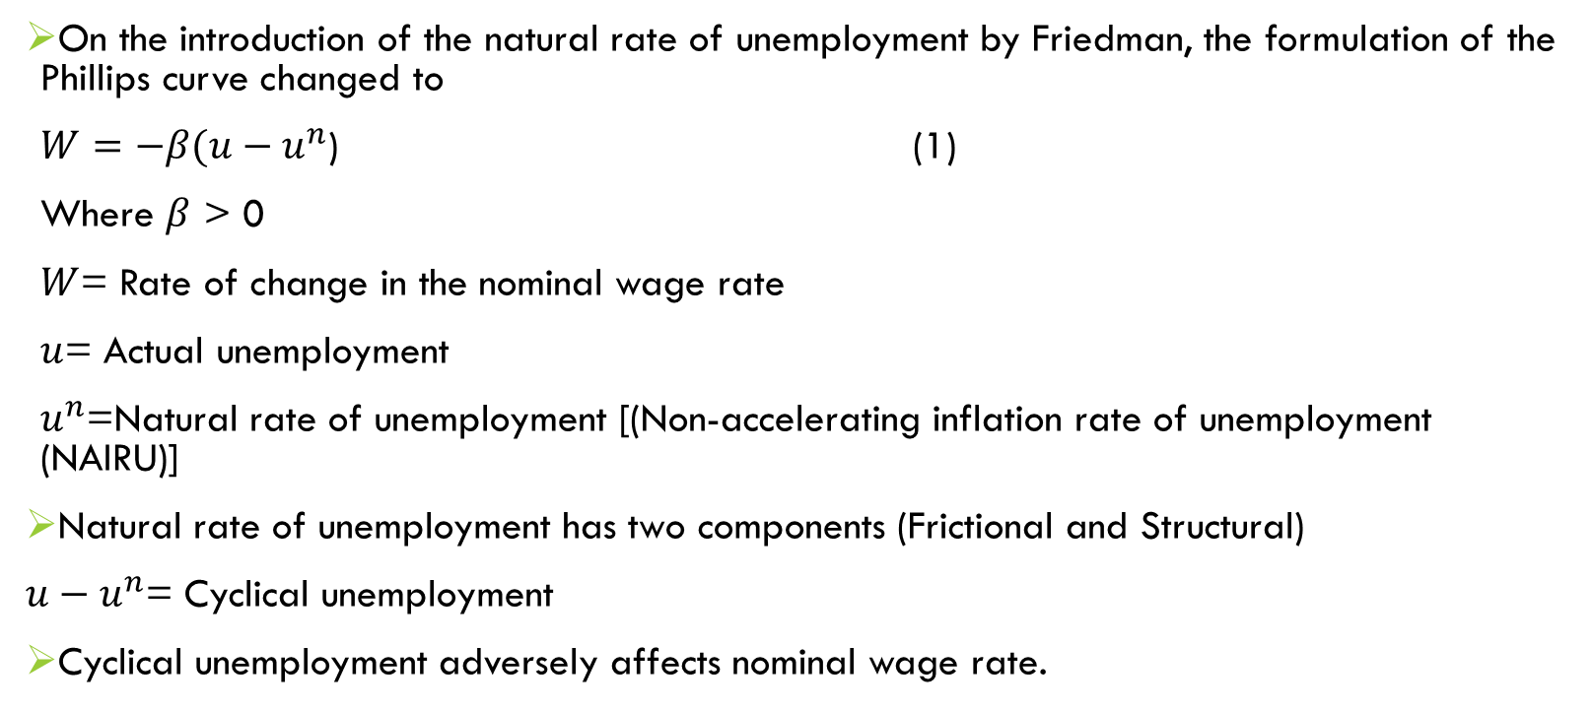
Cont…
On the introduction of the natural rate of unemployment by Friedman, the formulation of the Phillips curve changed to
$W=−β(u−u^{n}$) (1)
Where $β$ > 0
$W$= Rate of change in the nominal wage rate
$u$= Actual unemployment
$u^{n}$=Natural rate of unemployment [(Non-accelerating inflation rate of unemployment (NAIRU)]
Natural rate of unemployment has two components (Frictional and Structural)
$u−u^{n}$= Cyclical unemployment
Cyclical unemployment adversely affects nominal wage rate.

Slide 5
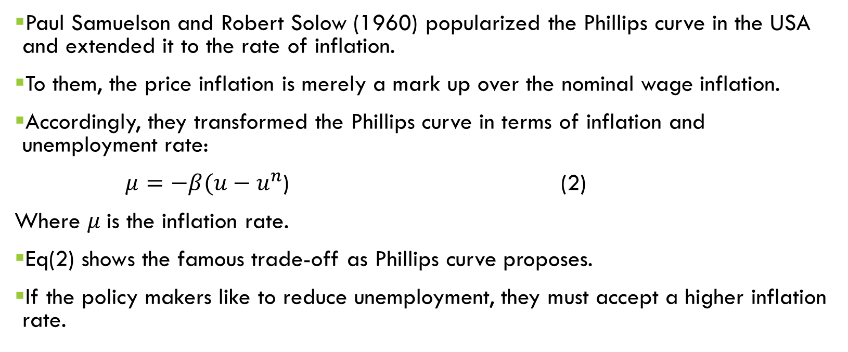
Cont…
Paul Samuelson and Robert Solow (1960) popularized the Phillips curve in the USA and extended it to the rate of inflation.
To them, the price inflation is merely a mark up over the nominal wage inflation.
Accordingly, they transformed the Phillips curve in terms of inflation and unemployment rate:
$μ=$ $−β(u−u^{n}$) (2)
Where $μ$is the inflation rate.
Eq(2) shows the famous trade-off as Phillips curve proposes.
If the policy makers like to reduce unemployment, they must accept a higher inflation rate.

Slide 6
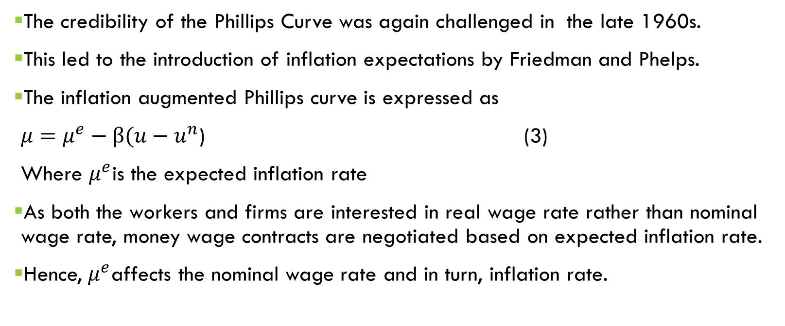
Cont..
The credibility of the Phillips Curve was again challenged in the late 1960s.
This led to the introduction of inflation expectations by Friedman and Phelps.
The inflation augmented Phillips curve is expressed as
$μ=μ^{e}−β(u−u^{n}\text{)}$ (3)
Where $μ^{e}$is the expected inflation rate
As both the workers and firms are interested in real wage rate rather than nominal wage rate, money wage contracts are negotiated based on expected inflation rate.
Hence, $μ^{e}$affects the nominal wage rate and in turn, inflation rate.

Slide 7
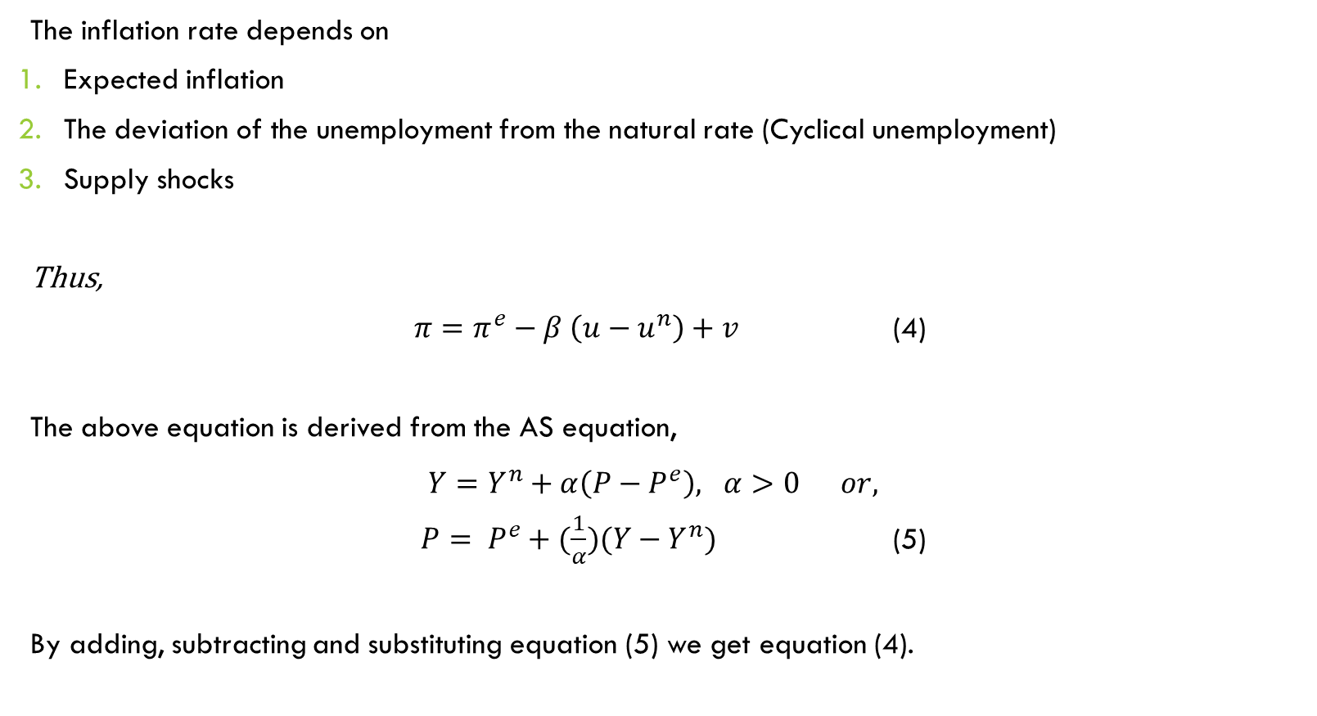
DeRiVation of the Phillips curve from the AS curve
The inflation rate depends on
Expected inflation
The deviation of the unemployment from the natural rate (Cyclical unemployment)
Supply shocks
Thus,
$π=π^{e}−β \left(u−u^{n}\right)+v$ (4)
The above equation is derived from the AS equation,
$Y=Y^{n}+α\left(P−P^{e}\right), α>0 or,$
$P= P^{e}+(\frac{1}{α})(Y−Y^{n})$ (5)
By adding, subtracting and substituting equation (5) we get equation (4).

Slide 8
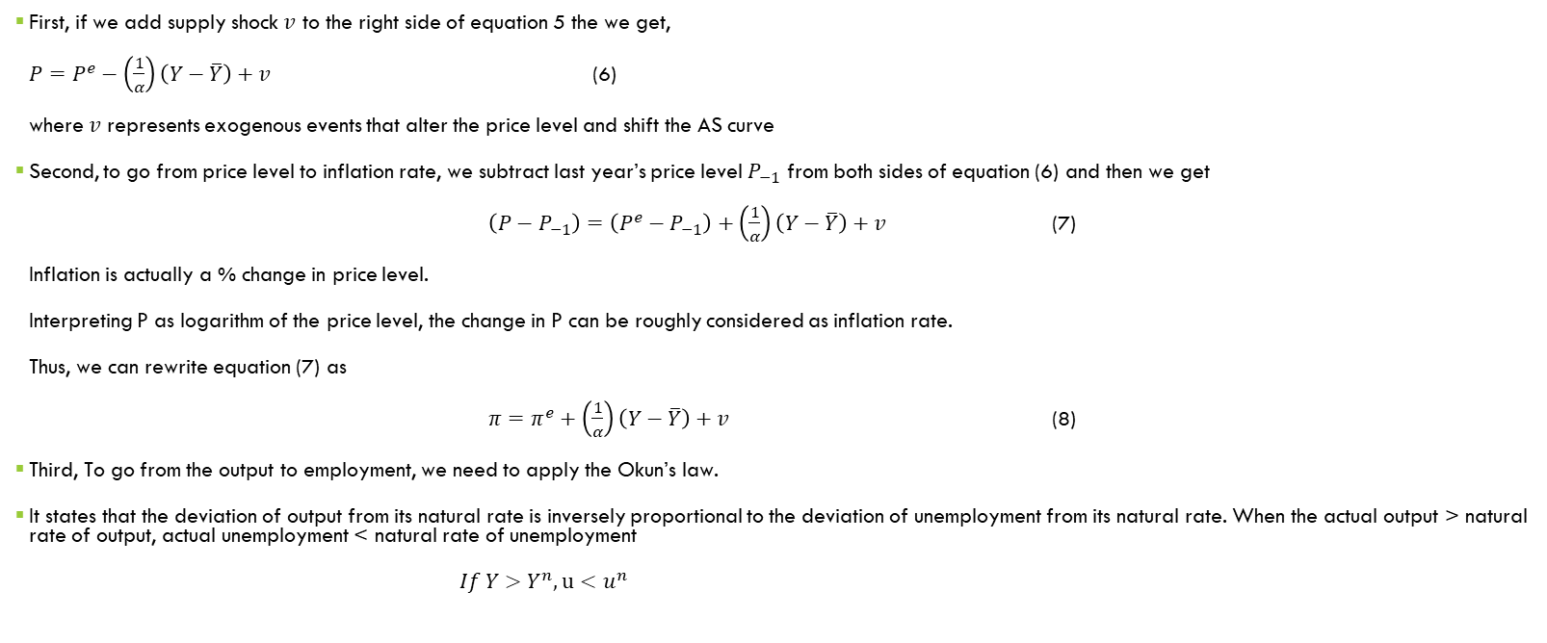
Cont…
First, if we add supply shock $v$ to the right side of equation 5 the we get,
$P=P^{e}−\left(\frac{1}{α}\right)\left(Y−\overline{Y}\right)+v$ (6)
where $v$ represents exogenous events that alter the price level and shift the AS curve
Second, to go from price level to inflation rate, we subtract last year’s price level $P_{−1}$ from both sides of equation (6) and then we get
$\left(P−P_{−1}\right)=\left(P^{e}−P_{−1}\right)+\left(\frac{1}{α}\right)\left(Y−\overline{Y}\right)+v$ (7)
Inflation is actually a % change in price level.
Interpreting P as logarithm of the price level, the change in P can be roughly considered as inflation rate.
Thus, we can rewrite equation (7) as
$π=π^{e}+\left(\frac{1}{α}\right)\left(Y−\overline{Y}\right)+v$ (8)
Third, To go from the output to employment, we need to apply the Okun’s law.
It states that the deviation of output from its natural rate is inversely proportional to the deviation of unemployment from its natural rate. When the actual output > natural rate of output, actual unemployment < natural rate of unemployment
$If Y>Y^{n}, u<u^{n}$

Slide 9
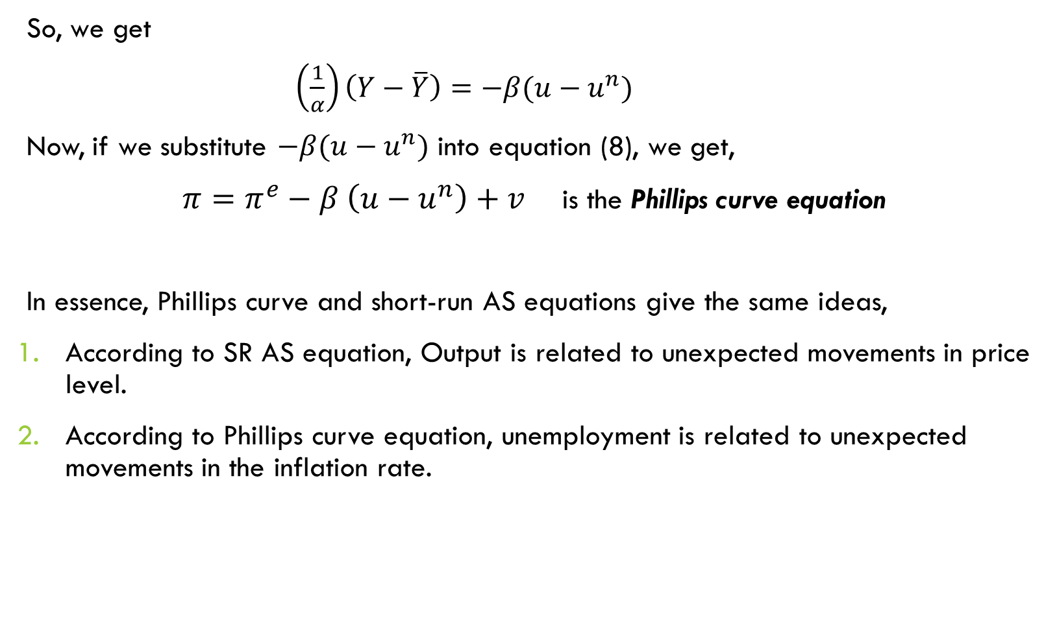
So, we get
$\left(\frac{1}{α}\right)\left(Y−\overline{Y}\right)=−β(u−u^{n})$
Now, if we substitute $−β(u−u^{n})$ into equation (8), we get,
$π=π^{e}−β \left(u−u^{n}\right)+v$ is the Phillips curve equation
In essence, Phillips curve and short-run AS equations give the same ideas,
According to SR AS equation, Output is related to unexpected movements in price level.
According to Phillips curve equation, unemployment is related to unexpected movements in the inflation rate.

Slide 10
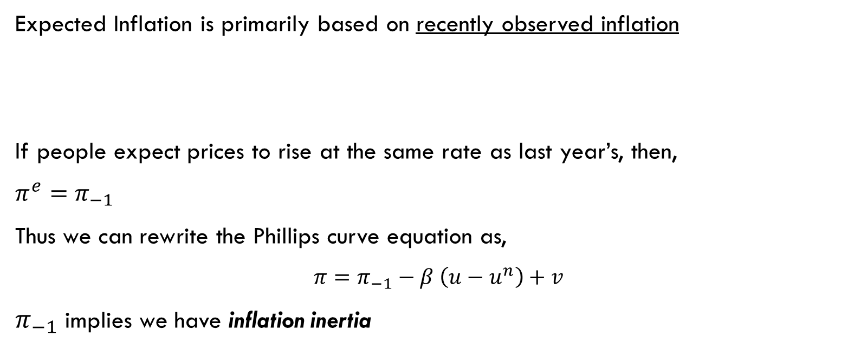
What determines expected inflation?
Expected Inflation is primarily based on recently observed inflation
If people expect prices to rise at the same rate as last year’s, then,
$π^{e}=π_{−1}$
Thus we can rewrite the Phillips curve equation as,
$π=π_{−1}−β \left(u−u^{n}\right)+v$
$π_{−1}$ implies we have inflation inertia
Adaptive expectations

Slide 11
the short run PHILLIPS Curve
Suppose that the rate of growth in the money supply is increased above the rate consistent with price stability → say, rate of growth of money supply increases from 3% to 5%
This will stimulate the aggregate demand and, the nominal income
Much of the rise in income will take the form of an increase in output and employment rather than in prices
People have been expecting prices to be stable, and prices and wages have been set for some time in the future
Producers will tend to react to the initial expansion in aggregate demand by increasing output, employees by working longer hours and unemployment by taking jobs now offered at former nominal wages

Slide 12

Derivation of the Short-run Phillips Curve
Price
(a) The Model of AD and AS (b) The Phillips Curve
Inflation Rate
level
Short-run aggregate supply
(percent
per year)
B
6%
B
106
A
High aggregate demand
102
Low aggregate demand
A
2%
Phillips curve
0
15,000
unemployment
is7%
16,000
unemployment is 4%
Quantity of output
0
4%
output is 16,000
7%
output is15,000
Unemployment Rate (percent)
This figure assumes a price level of 100 for the year 2019 and charts possible outcomes for the year 2020. Panel
(a) shows the model of aggregate demand and aggregate supply. If aggregate demand is low, the economy is at point A; output is low (15,000), and the price level is low (102). If aggregate demand is high, the economy is at point B; output is high (16,000), and the price level is high (106). Panel (b) shows the implications for the Phillips curve. Point A, which arises when aggregate demand is low, has high unemployment (7%) and low inflation (2%). Point B, which arises when aggregate demand is high, has low unemployment (4%) and high inflation (6%).

Slide 13
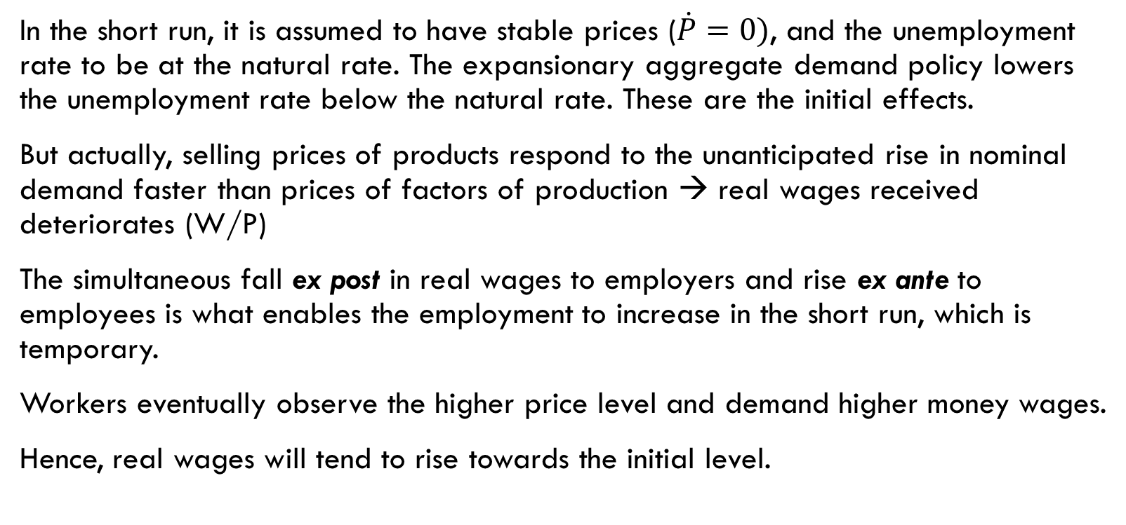
In the short run, it is assumed to have stable prices ($\dot{P}=0)$, and the unemployment rate to be at the natural rate. The expansionary aggregate demand policy lowers the unemployment rate below the natural rate. These are the initial effects.
But actually, selling prices of products respond to the unanticipated rise in nominal demand faster than prices of factors of production → real wages received deteriorates (W/P)
The simultaneous fall ex post in real wages to employers and rise ex ante to employees is what enables the employment to increase in the short run, which is temporary.
Workers eventually observe the higher price level and demand higher money wages.
Hence, real wages will tend to rise towards the initial level.

Slide 14
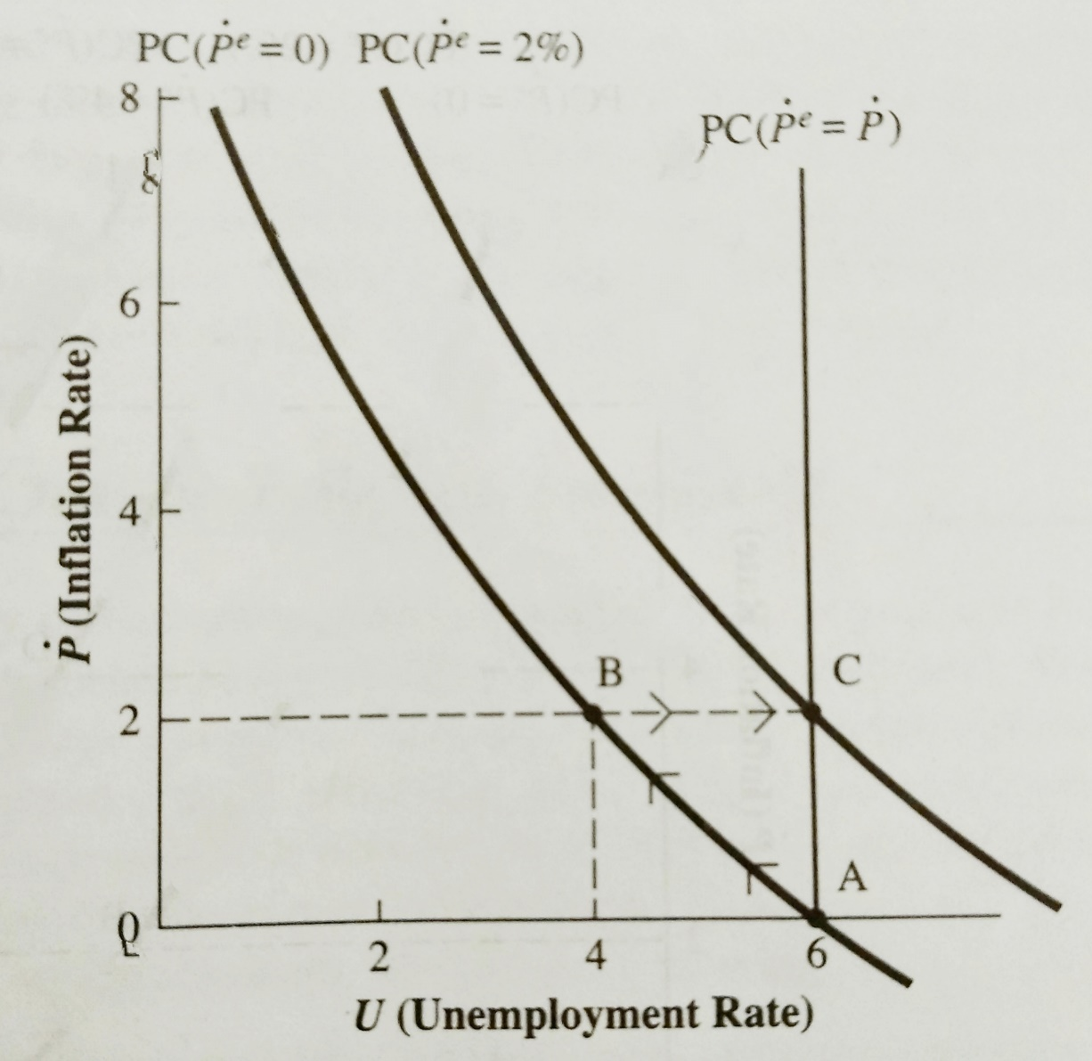
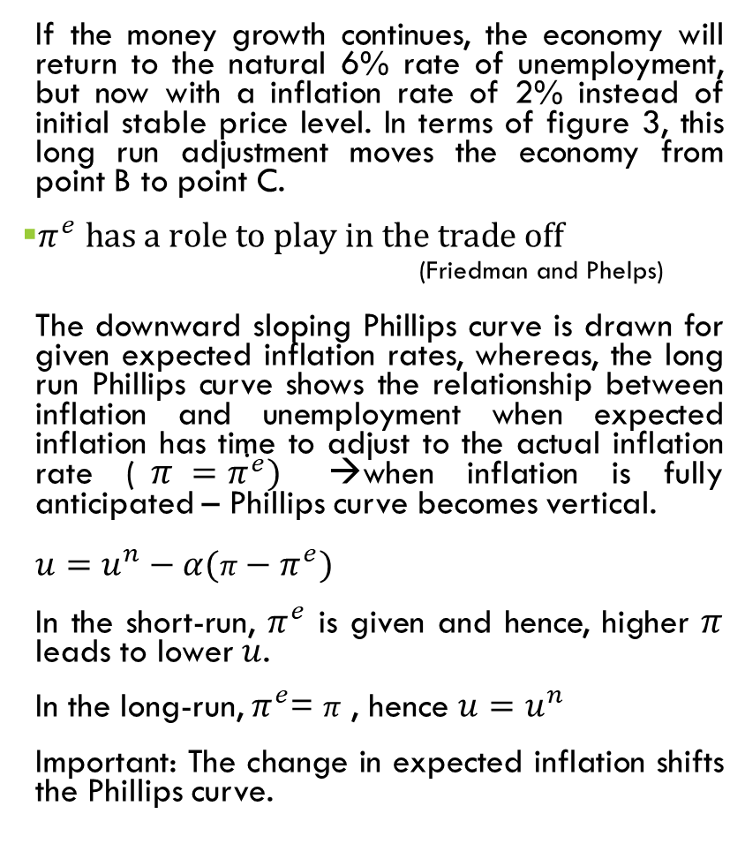
Shift in the Phillips Curve: Role of Expectations
If the money growth continues, the economy will return to the natural 6% rate of unemployment, but now with a inflation rate of 2% instead of initial stable price level. In terms of figure 3, this long run adjustment moves the economy from point B to point C.
$π^{e} has a role to play in the trade off$
(Friedman and Phelps)
The downward sloping Phillips curve is drawn for given expected inflation rates, whereas, the long run Phillips curve shows the relationship between inflation and unemployment when expected inflation has time to adjust to the actual inflation rate ($π =\dot{π^{e}})$ →when inflation is fully anticipated – Phillips curve becomes vertical.
$u=u^{n}−α(π−π^{e})$
In the short-run, $π^{e}$ is given and hence, higher $π$ leads to lower $u$.
In the long-run, $π^{e}$= $π$ , hence $u=u^{n}$
Important: The change in expected inflation shifts the Phillips curve.
Figure 3: Short run and Long run Phillips curve

Slide 15
Long-run Phillips Curve
(a) The Model of AD and AS
(b) The Phillips Curve Long-run
Price level
Inflation
Long-run aggregate supply
Rate
Phillips curve
1. An increase in
the money supply
B
B
P
2
increases aggregate
demand . . .
3. . . . and increases the inflation rate . . .
A
P₁
2. . . . raises the price level . . .
A
AD
2
Aggregate demand, AD₁
0
Natural rate of output
Quantity of output
0
Natural rate
of output
Unemployment
Rate
4. . . . but leaves output and unemployment at their natural rates.
Panel (a) shows the model of aggregate demand and aggregate supply with a vertical aggregate-supply curve. When expansionary monetary policy shifts the aggregate-demand curve to the right from AD₁ to AD₂, the equilibrium moves from point A to point B. The price level rises from P₁ to P₂, while output remains the same. Panel (b) shows the long-run Phillips curve, which is vertical at the natural rate of unemployment. In the long run, expansionary monetary policy moves the economy from lower inflation (point A) to higher inflation (point B) without changing the rate of unemployment.

Slide 16
Cont…
According to Friedman and Phelps, the trade-off exists only in the short-run but not in the long-run.
Policy makers can pursue expansionary monetary policy to lower unemployment but ultimately, unemployment returns to its natural rate and hence, more expansionary monetary policy leads only to higher inflation.
Monetary Neutrality: The Classical proposition
Monetary policy does not affect real output. There is no relationship between inflation and unemployment in the long-run.
Unemployment does not depend on money growth and inflation in the long-run

Slide 17
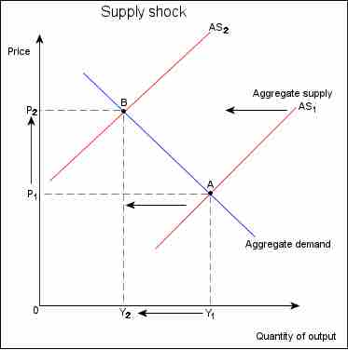
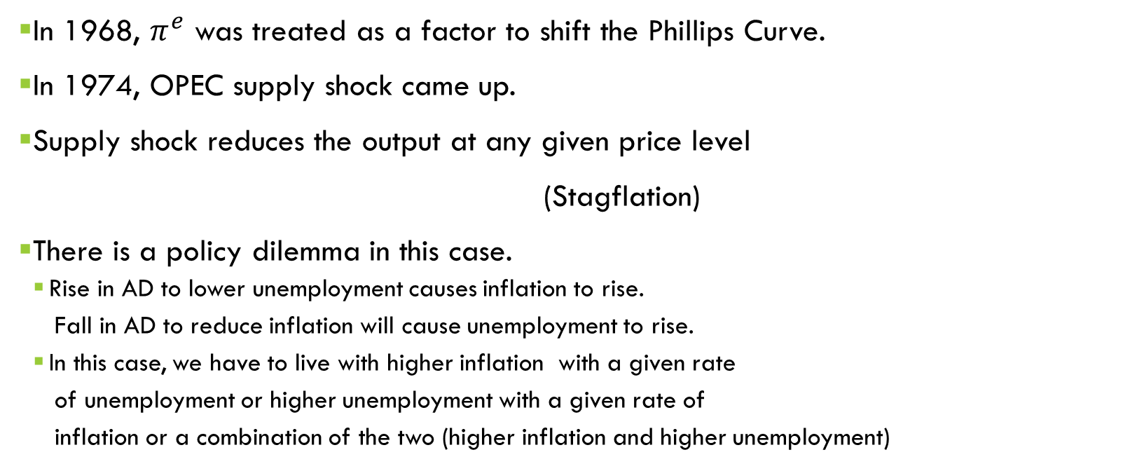
Shift in the Phillips Curve: Role of Supply Shock
In 1968, $π^{e}$ was treated as a factor to shift the Phillips Curve.
In 1974, OPEC supply shock came up.
Supply shock reduces the output at any given price level
(Stagflation)
There is a policy dilemma in this case.
Rise in AD to lower unemployment causes inflation to rise.
Fall in AD to reduce inflation will cause unemployment to rise.
In this case, we have to live with higher inflation with a given rate
of unemployment or higher unemployment with a given rate of
inflation or a combination of the two (higher inflation and higher unemployment)

Slide 18
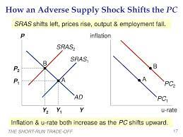

Slide 19
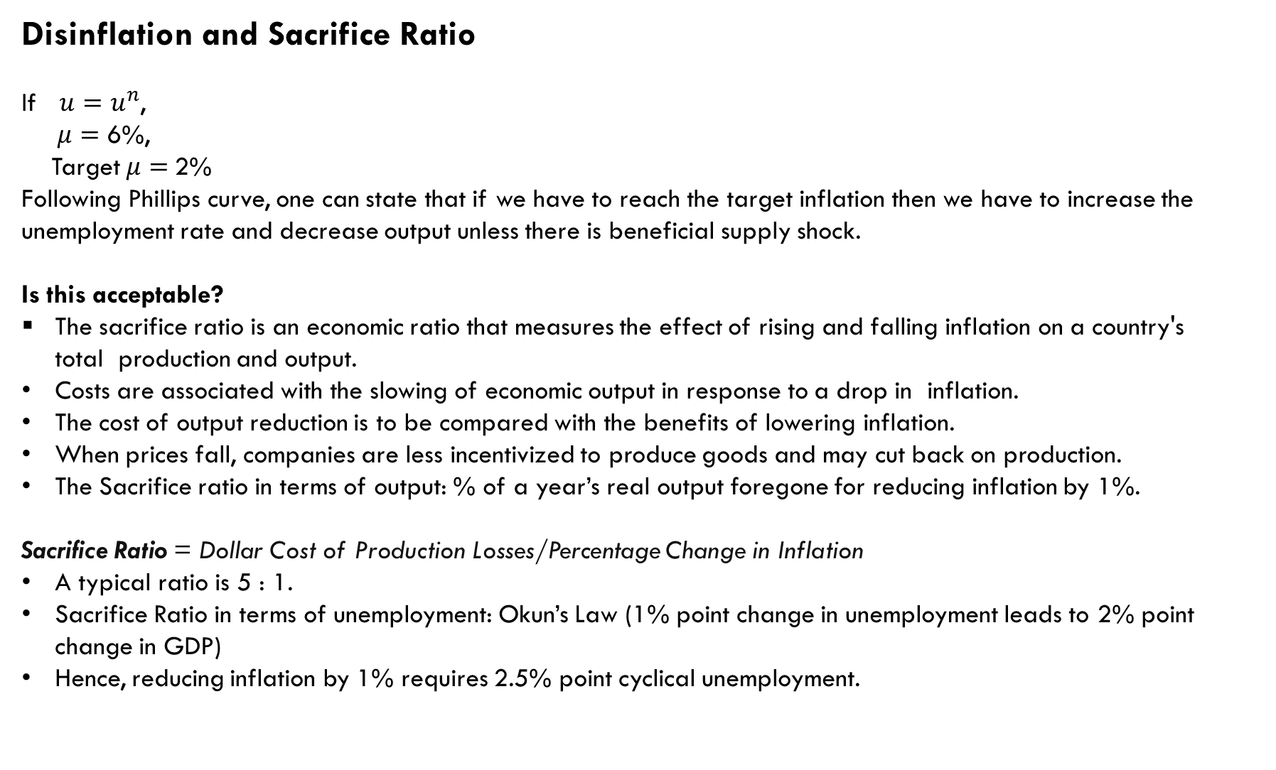
Disinflation and Sacrifice Ratio
If $u=u^{n}$,
$μ=$ 6%,
Target $μ=$2%
Following Phillips curve, one can state that if we have to reach the target inflation then we have to increase the unemployment rate and decrease output unless there is beneficial supply shock.
Is this acceptable?
The sacrifice ratio is an economic ratio that measures the effect of rising and falling inflation on a country's total production and output.
Costs are associated with the slowing of economic output in response to a drop in inflation.
The cost of output reduction is to be compared with the benefits of lowering inflation.
When prices fall, companies are less incentivized to produce goods and may cut back on production.
The Sacrifice ratio in terms of output: % of a year’s real output foregone for reducing inflation by 1%.
Sacrifice Ratio = Dollar Cost of Production Losses/Percentage Change in Inflation
A typical ratio is 5 : 1.
Sacrifice Ratio in terms of unemployment: Okun’s Law (1% point change in unemployment leads to 2% point change in GDP)
Hence, reducing inflation by 1% requires 2.5% point cyclical unemployment.

Slide 20
Cont…
1% reduction in Inflation requires 5 % fall in real GDP.
4% reduction in Inflation requires 20 % fall in real GDP.
Equivalently, 4% reduction in Inflation requires 10 % rise in cyclical unemployment.
The disinflation may take various forms.
Ex: Rapid Disinflation: Lowering output by 10% for 2 years.
Moderate Disinflation: Lowering output by 5% for 4 years.
Gradual Disinflation: Lowering output by 2% for 10 years.

Slide 21
MORE on The Natural Rate Theory
Short-run changes in the money supply are the primary determinants of fluctuations in output and employment
However, real effects of changes in the money supply, can be determined in the long-run, with the help of real output and real employment
The basis of this proposition is Milton Friedman’s theory of the natural rates of unemployment and output
According to the natural rate theory, there exists an equilibrium level of output and an accompanying rate of unemployment determined by the supply of factors of production, technology, and institutions of the economy (i.e., determined by real factors). This is Friedman’s natural rate.
Equilibrating forces cause output and employment to return to its natural rate in the long-run

Slide 22
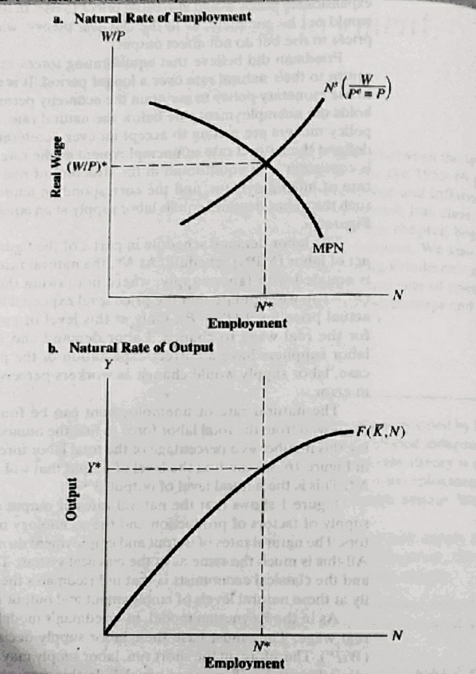
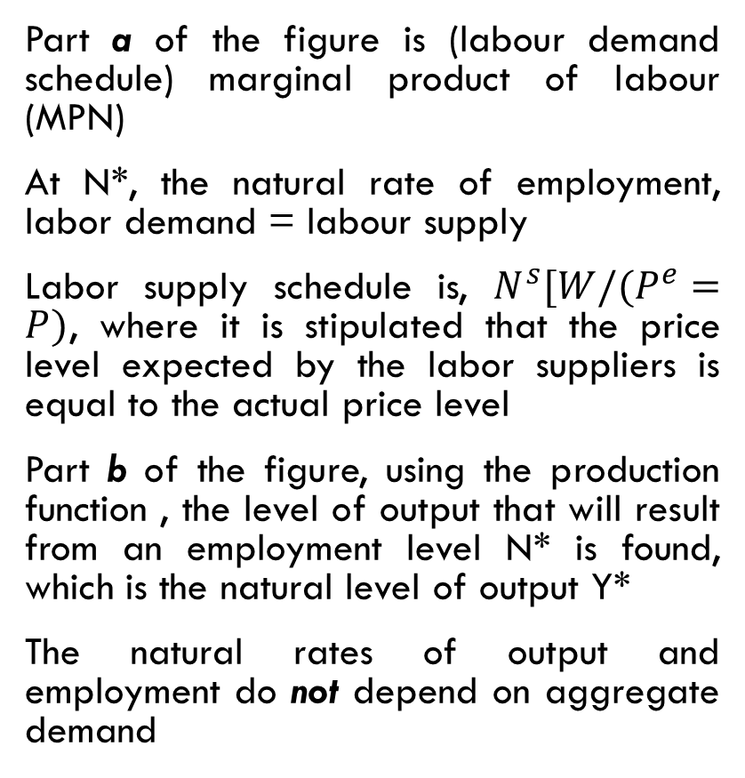
Figure 1: Natural rates of employment and output
Part a of the figure is (labour demand schedule) marginal product of labour (MPN)
At N*, the natural rate of employment, labor demand = labour supply
Labor supply schedule is, $N^{s}[W/(P^{e}=P)$, where it is stipulated that the price level expected by the labor suppliers is equal to the actual price level
Part b of the figure, using the production function , the level of output that will result from an employment level N* is found, which is the natural level of output Y*
The natural rates of output and employment do not depend on aggregate demand

Slide 23
Determinants of Natural rate of Unemployment
Natural rate of Unemployment, also termed as nonaccelerating inflation rate of unemployment (NAIRU), would be the rate “ground out” by an equilibrium process that would also be affected by structural characteristics of labour and commodity markets, including market imperfections, stochastic variability in demands and supplies, the cost of gathering information of job vacancies and labour availabilities, the cost of mobility and so on. These additional characteristics can be explained by frictional and structural unemployment.
Hysteresis
Hysteresis is a property that, when a variable is shocked away from an initial value, it shows no tendency to return, even when the shock is over, Persistently, high unemployment rates in many European countries have led economists argue that unemployment exhibits hysteresis. High unemployment in the recessions of the 1970s and 1980s, which are cyclical in nature had long-lasting effects on unemployment in later years.

Slide 24
Costs of Inflation
Fall in purchasing power/inflation fallacy
Shoeleather cost
Menu cost
Relative price variability and misallocation of resources
Inflation induced tax distortions
Arbitrary redistribution of wealth

Slide 25
A fall in purchasing power: The inflation Fallacy
When inflation occurs,
Buyers pay more or buy fewer goods.
Indicates a decline in standard of living
But the sellers earn more.
As most of the people earn selling their services like labour, there is inflation income.
Hence, inflation does not in itself reduce people’s purchasing power.

Slide 26
Menu cost
When inflation/deflation occurs, the prices are to be changed, which costs the economy.
Applies to all kinds of businesses.

Slide 27
ShoeLeather cost
When inflation occurs, it erodes the real value of the money one holds.
Nominal interest rate rises.
People like to hold less real balances and keep more wealth in interest-bearing savings accounts.
Frequent visits to banks
The cost of reducing the money holding is the shoeleather cost

Slide 28
Relative Price Variability and Misallocation of resources
If a particular restaurant prints a new menu with new prices once in a year.
If annual inflation rate is 24%, its relative prices will fall by 2% per month.
Market economies rely on relative prices to allocate scarce resources.
When inflation distorts relative prices, consumer’s and producer’s decisions are distorted.

Slide 29
Inflation Induced tax distortions
If Inflation is not fully indexed
Bracket creep
Capital gain tax
Tax treatment on interest income

Slide 30
Bracket creep
A movement to higher tax brackets as taxable income increases
Ex
Up to 1.5 Lakh Nil
1.5 to 3 Lakh 10%
3 to 5 Lakh 20%
Above 5 Lakh 30%
If taxable income is Rs 4.5 Lakh: Income tax will be Rs 45000.
If inflation rate be 20%, taxable income increases by 20%
Total Income becomes Rs 5.40 Lakh: Income Tax becomes Rs 67000
Increase in tax by 28% but inflation has increased by 20%.
If the tax is fully inflation indexed, the tax brackets are fully indexed.

Slide 31
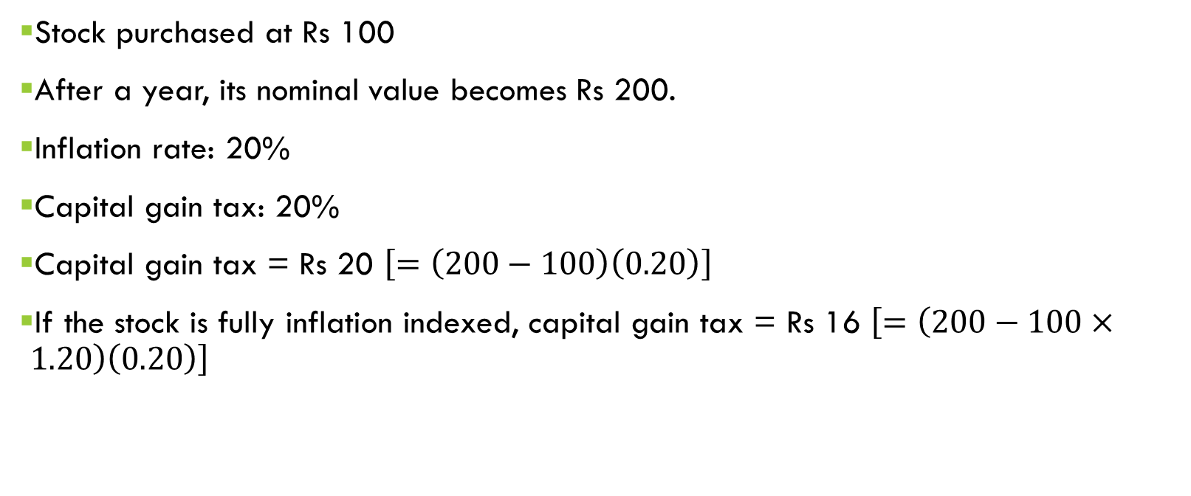
Capital gain tax: An Example
Stock purchased at Rs 100
After a year, its nominal value becomes Rs 200.
Inflation rate: 20%
Capital gain tax: 20%
Capital gain tax = Rs 20 $\left[=\left(200−100\right)\left(0.20\right)\right]$
If the stock is fully inflation indexed, capital gain tax = Rs 16 $\left[=\left(200−100×1.20\right)\left(0.20\right)\right]$

Slide 32
Tax treatment on interest income: An Example
 | USA | India
Real interest rate | 4% | 4%
Inflation rate | 0 | 8
Nominal interest rate (real interest rate + inflation rate) | 4 | 12
Reduced interest due to 25% tax (0.25 x nominal interest rate) | 1 | 3
After tax nominal interest rate (0.75 x nominal interest rate) | 3 | 9
After-tax real interest rate (After-tax nominal interest rate – inflation rate) | 3 | 1

Slide 33
Redistribution of Wealth: An Example
Expected inflation: 0
Nominal interest =Real interest =4%
Actual inflation = 6%
Borrowing = Rs 10000 for a year
Return = 10400 after a year
Purchasing power of Rs 10400 after a year = 10400/1.06 = 9811
This is less than the purchasing power of Rs 10000 before a year.

Slide 34
Arbitrary redistribution of wealth
Inflation causes additional costs when it is unexpected.
Unexpected inflation redistributes wealth arbitrarily.
There is redistribution of wealth between creditors and debtors.
If inflation can be predicted, both could take inflation into account when setting the nominal interest rate.
If it is not predictable, it imposes a risk on either or both.

Slide 35
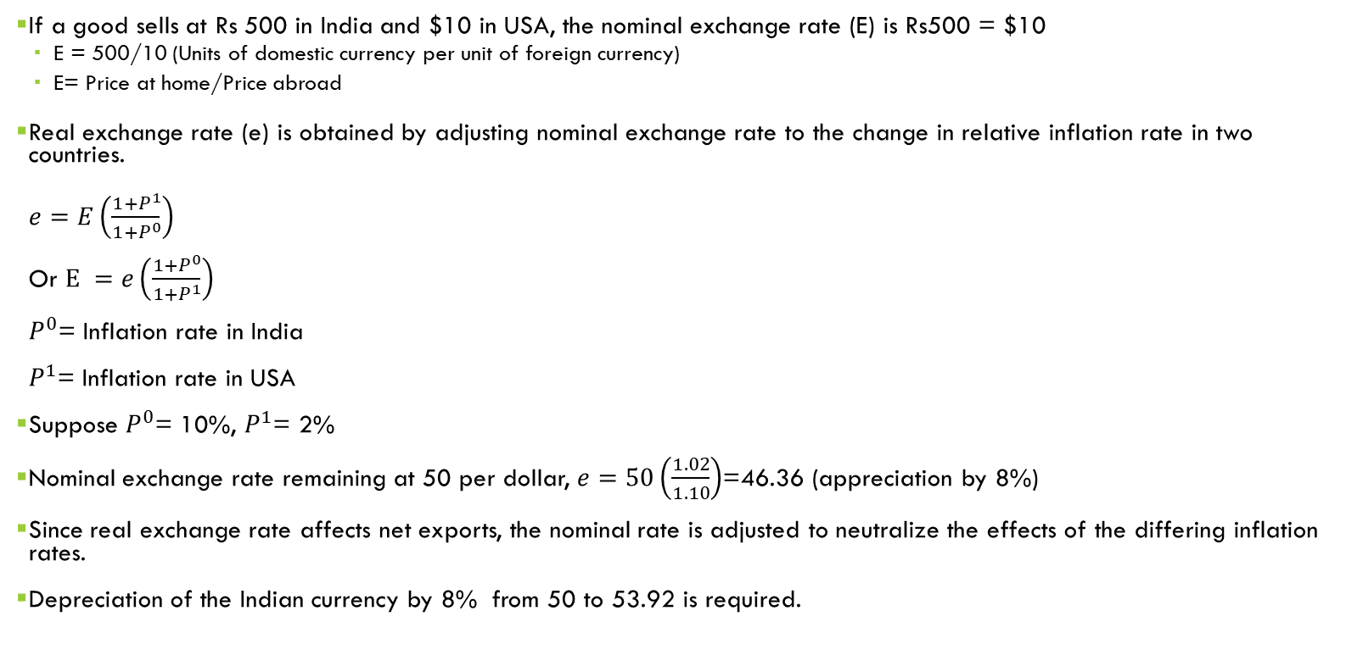
Inflation and Foreign Exchange rate
If a good sells at Rs 500 in India and $10 in USA, the nominal exchange rate (E) is Rs500 = $10
E = 500/10 (Units of domestic currency per unit of foreign currency)
E= Price at home/Price abroad
Real exchange rate (e) is obtained by adjusting nominal exchange rate to the change in relative inflation rate in two countries.
$e=E\left(\frac{1+P^{1}}{1+P^{0}}\right)$
Or $E =e\left(\frac{1+P^{0}}{1+P^{1}}\right)$
$P^{0}$= Inflation rate in India
$P^{1}$= Inflation rate in USA
Suppose $P^{0}$= 10%, $P^{1}$= 2%
Nominal exchange rate remaining at 50 per dollar, $e=50\left(\frac{1.02}{1.10}\right)$=46.36 (appreciation by 8%)
Since real exchange rate affects net exports, the nominal rate is adjusted to neutralize the effects of the differing inflation rates.
Depreciation of the Indian currency by 8% from 50 to 53.92 is required.

Slide 36
Inflation Tax
When the government raises revenue by printing new money, it is considered to levy an inflation tax.
When the government prints money, the price level rises, and hence the value of the dollar one holds decreases.

Slide 37
Books for REFERENCES
Macroeconomics: Theory and Applications, G S Gupta, Tata McGraw Hill
Principles of Macroeconomics, N G Mankiw, South-Western Cengage Learning

